Slide 1


NVE CORPORATION
Leaders in Practical Spintronics
https://youtu.be/hfCbw0kSG2c

Slide 2
This Presentation
Sensor Product Lines
NVE Sensor Advantages
Use Cases
New and Upcoming Products
Distributor/Rep Support Resources
6/10/20

Slide 3
“GMR can be considered
one of the first real
applications of the promising
field of nanotechnology.”
—Nobel Committee
October 2007

Slide 4
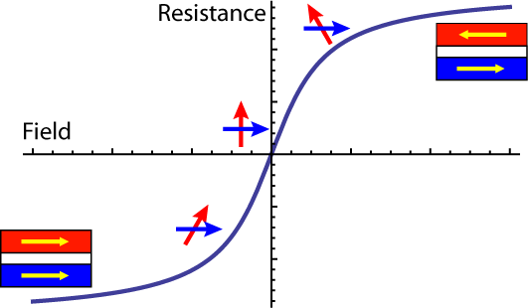
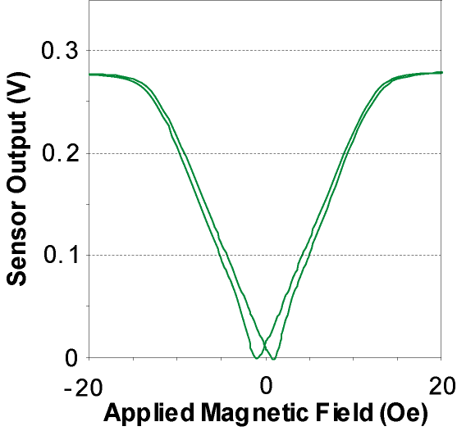
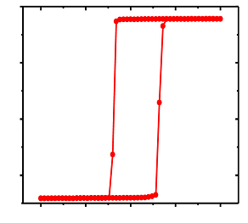
Digital, Bipolar, and Omnipolar Sensors
Digital
Bipolar
Omnipolar
Field
Memory/data storage
Latching/digital sensors
Vector magnetometry
Current sensing
Position sensing
Current amplitude
  AD/ADL/AHL/AHT/AFL
  Digital Switches
  ALT Analog Sensors
  AA-Series Analog Sensors
6/10/20

Slide 5

NVE Sensor Lines
Analog-Output Sensors
  AA-Series GMR Magnetometers (magnetic fields and currents)
  AKT001 TMR Magnetometers Sensors (fields to 1 T; wide dynamic range)
  ALT-Series High Temperature, Low Hysteresis TMR Magnetometers
  AB-Series GMR Gradiometers (magnetic pickups)
  ABL-Series GMR Gear Tooth Sensors (“GT Sensors”)
  AAT-Series TMR Angle Sensors
Digital-Output Switches
  AD-Series General Purpose GMR Switches
  ADL/AHL/AHT-Series 1.1 mm Nanopower Switches
  AFL-Series 2.5 mm DFN Lower Voltage Switches
  AKL-Series Two-Wire Gear Tooth Sensors
  ADT-Series TMR Angle/Rotation Sensors
Smart Magnetometers
  SM124/5 GMR, 1 mT / 4 mT, 10% accuracy, 10 kS/s, I²C, 2.5 mm TDFN, low-cost
  SM225/8 TMR, 15 mT, 2% accuracy, 15 kS/s, SPI / I²C, 2.5 mm TDFN
  SM324 TMR, 2 mT, 0.3% accuracy, 300 S/s, 2.5 mm TDFN
Smart Angle Sensors
  ASR0x2 TMR, ±1°, 20 kS/s, SPI / I²C / ABZ, 2.5 mm TDFN
  ASR001 TMR, ±0.5°, 3 kS/s, I²C, 3 mm TDFN
Coming Q1 ‘21

Slide 6
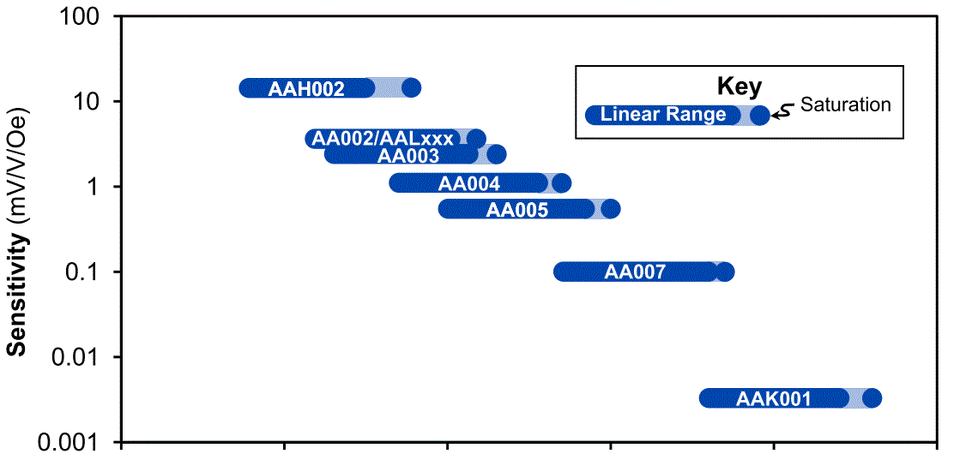
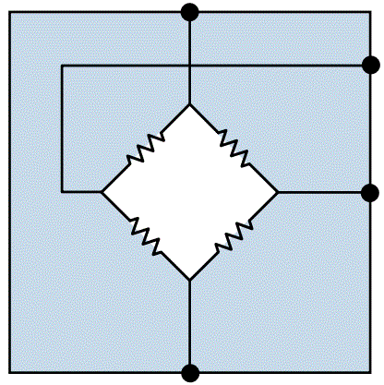
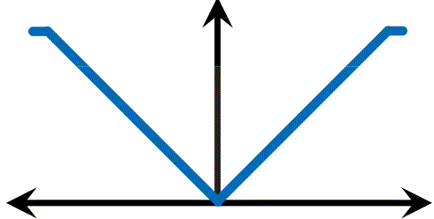
Analog Sensors
Supply
OUT-
OUT+
OUT
New!
GND
TMR
AKT001
Field
0.1 1 10 100 1000 10k Oe
0.01 0.1 1 10 100 1000 mT
Magnetic Field Range
9/10/20

Slide 7
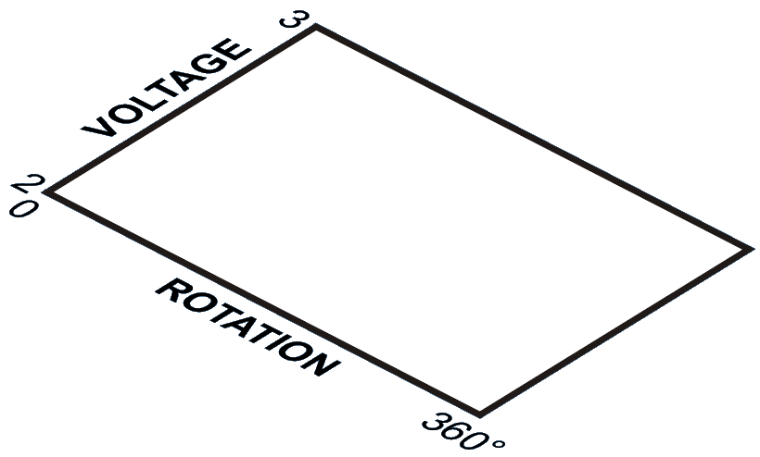
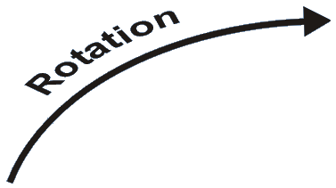
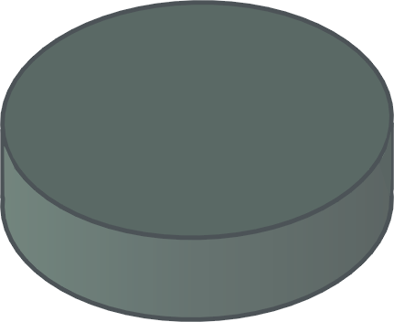

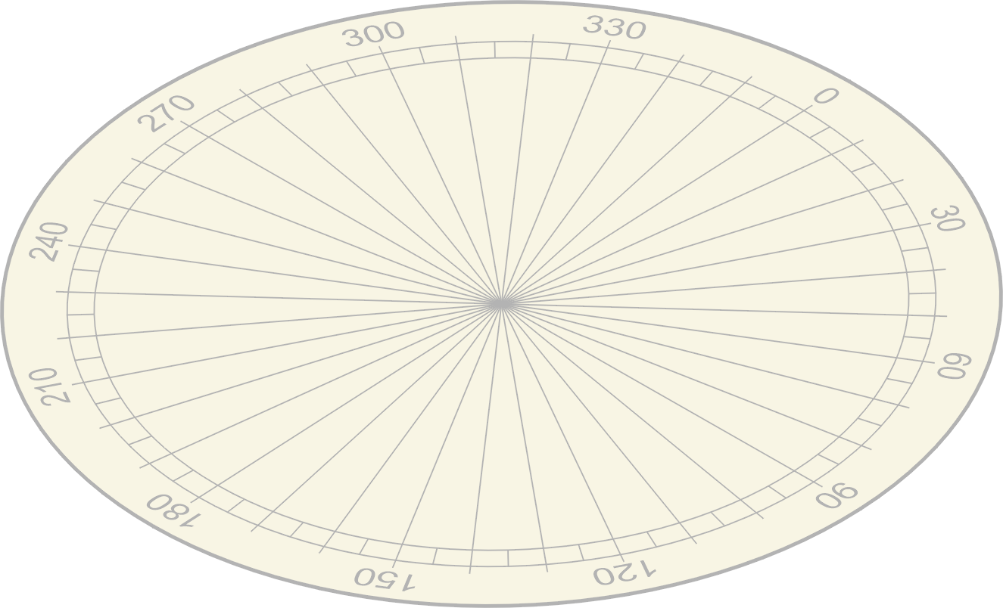



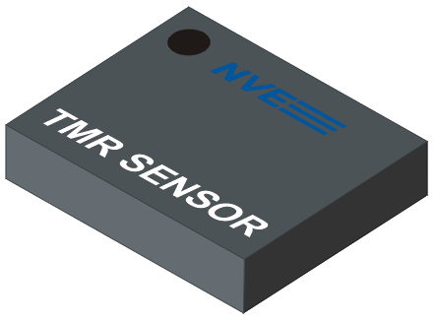

AAT-Series
Analog Angle Sensors
Utility meters
Industrial control
Automotive
6/10/20

Slide 8
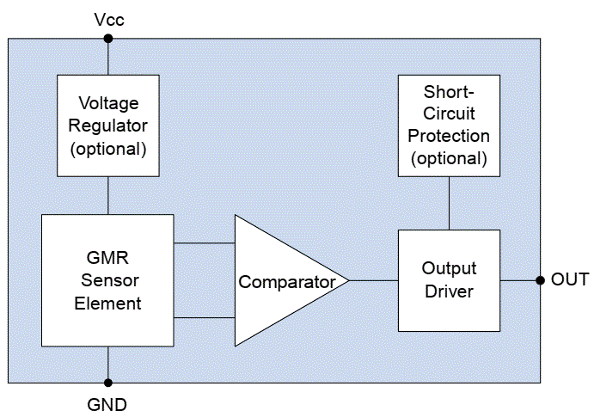
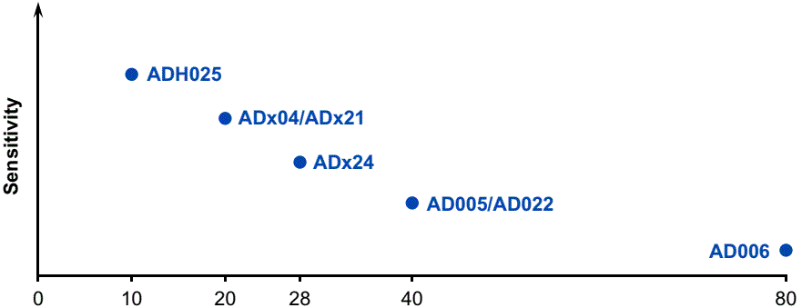
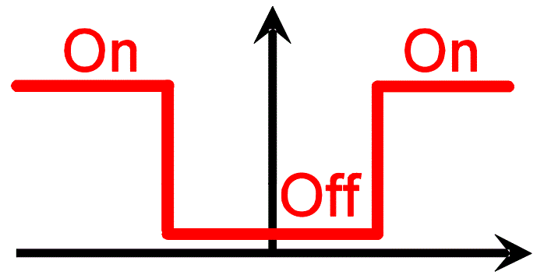
Digital Switch Sensors
AD-Series
  4.5 – 30V supply
  Precise operate points
  Excellent temperature stability
AHK991
0 10 20 28 40 80 3500 Oe
0 1 2 2.8 4 8 350 mT
6/10/20

Slide 9

Nanopower Switch Sensors
Ultra-low power
  Continuous GMR (~30 µA)
  Duty-cycled GMR (~100 nA)
  Continuous TMR (~1 µA)
Ultraminiature
  1.1 mm x 1.1 mm x 0.4 mm
Ultrasensitive
  As low as 1 mT switching
Low voltage
  Industrial (2.4 – 4.2 V)
  Medical (0.9 V – 2.4 V)
1000
100
ADL9XX
AHL9XX
Continuous Operation
µ
AFL0XX
Power (uW)
10
1
AHT9XX
TMR
AHK9XX
0.1
AHL0XX
ADL1XX
0.1
1
10
100
1000
Duty-Cycled GMR
Operate Field (mT)
6/10/20

Slide 10
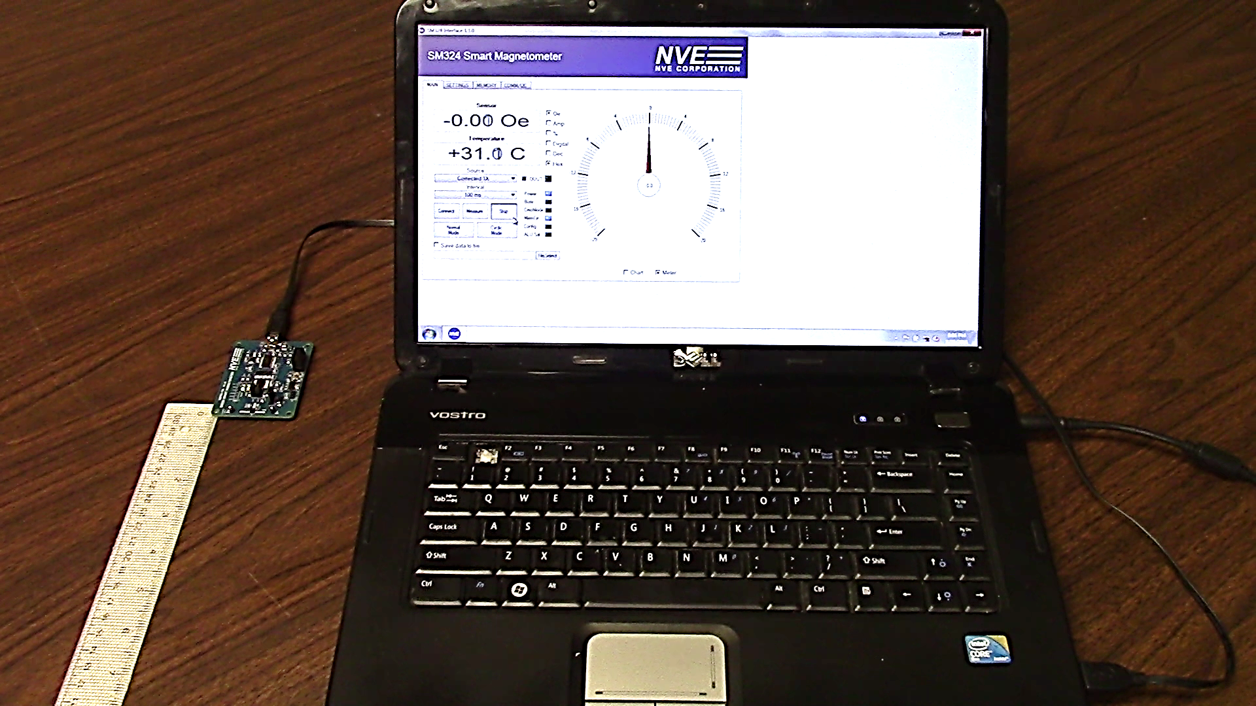

Smart Sensors
Angle sensors for rotation
Magnetometers for proximity or current
Factory calibrated
Linearized and temperature compensated
Ultraminiature 2.5 mm DFN packages
6/10/20

Slide 11


Smart Sensors
Part | Proximity, Current, or Angle | Tech- nology | Accur- acy | Speed (Samples/s) | Interf-ace | Features | Status
SM124/5 |  | GMR | 5% | 10,000 | I²C, Digital Threshold | Low Cost | Introduced Q4 ‘18
SM225/8 |  | TMR | 2% | 15,000 | SPI / I²C | High Accuracy / High Spd | Introduced Q2 ‘19
SM324 |  | TMR | 0.3% | 300 | I²C, Digital Threshold | Ultrahigh Accuracy | Introduced Q3 ‘18
ASR002 / 12 / 22 |  | TMR | 2° | 12,500 | SPI / I²C / ABZ | High Speed | Introduced Q1’ 19
ASR001 |  | TMR | 0.5° | 2,500 | I²C, PWM, Analog | High Accuracy | Q1 ‘21
9/22/20

Slide 12
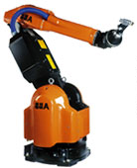
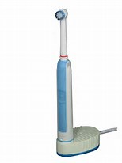
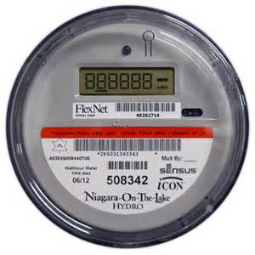
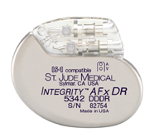
NVE Sensor Markets
Industrial control
AD-Series for proximity and cylinder position
AAT for angle sensing and cylinder position
GT for gear-tooth speed / direction / position
SM/ASR-Series smart sensors
Automotive / electric vehicles
SM-Series smart sensors for current sensing
ASR-Series smart angle sensors
Consumer / small electrics
1.1 x 1.1 mm ADL/AHL/AHT-Series proximity sensors
Energy
AAT and ADT-Series for meter rotation
Medical devices
Custom sensors
6/10/20

Slide 13


The Four “Bs” of NVE Sensors
  Boxes—Miniaturization of medical and other devices
  Bullet-proof—Reliable; proven in medical, aerospace
  Batteries—Power as low as nanowatts
  Brains—Easy interface to the Internet of Things;
  I²C / SPI / Digital / Analog interfaces
6/10/20

Slide 14
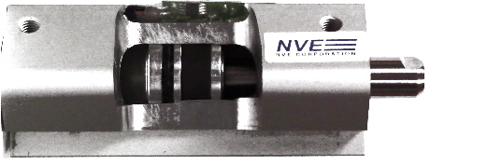
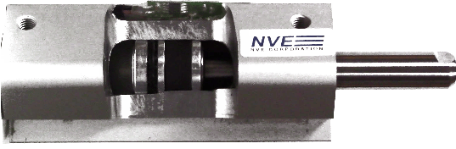
Use Case: Cylinder Position Sensing
Parts used:
AD-Series (high voltage) ADL-Series (ultralow power) AAT-Series (arcTan linear positioning) SM12x (programmable thresholds)
Applications
Robotics and mechatronics
Proximity sensing
Security
Advantages
High sensitivity
Precise and repeatable
Low power
www.nve.com/application-thumbnails

Slide 15
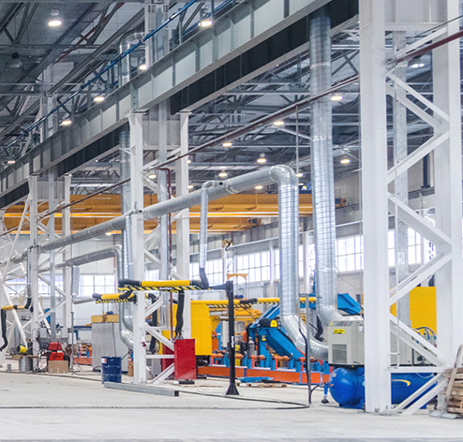
Use Case: Process Control Proximity Detection
Part used: SM124 Smart Magnetometer
High-sensitivity sensor (1 mT)
Very simple software
(1-byte data, no commands,
automatic repetitive read)
Fast prototyping
6/25/19

Slide 16
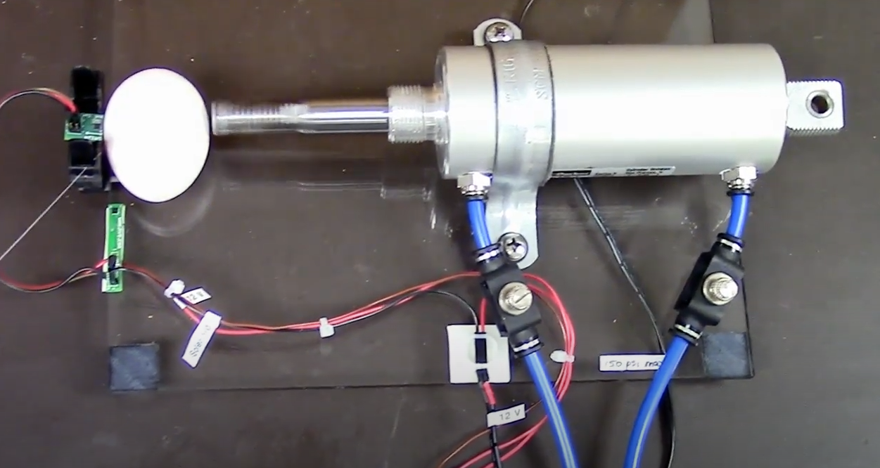
Use Case: Pneumatic Cylinder Limit Switch
https://youtu.be/OwZafMZB58Q
Customer Interface: Programmable Switch Parts used: SM124/5 GMR Smart Sensors

Slide 17
Use Case: Current Sensing
Parts used:
SM324 (high accuracy) SM225 (high speed)
Applications
Overcurrent protection
Battery charging
Ignition monitoring
Advantages
Fully isolated
Miniaturization
No insertion loss
H
Current Trace
TMR/ GMR Sensor
Top view
Cross-section
PCB
Trace on any PCB layer, including under sensor
Currents from 0.1A – 200A (PCB traces)
1A – 1000+A (busbar)

Slide 18

NVE Sensor Advantages Over Shunts
  No insertion loss
  Inherent isolation
  Unlimited common mode voltage
  (vs. 63V for typical analog front-ends)
  Built-in overcurrent detection by magnetic saturation (shunt overcurrent can overdrive amplifiers)
  Low parts count (no amplifier or transient suppression)
550 mW
Heat Loss
22 mΩ
shunt
5A
12V / 60W Motor
Shunts are innefficient
6/10/20

Slide 19
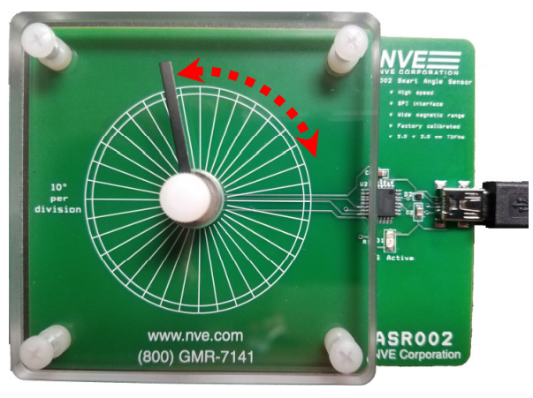
Use Case: Rotary Potentiometer Replacement
Parts used:
ASR-Series (digital interface) AAT-Series (low power)
Applications
Factory Controls
Consumer appliances
End of line calibration
Advantages
Noncontact for maximum durability
Robust misalignment and vibration tolerance
Temperature stability
www.nve.com/application-thumbnails

Slide 20
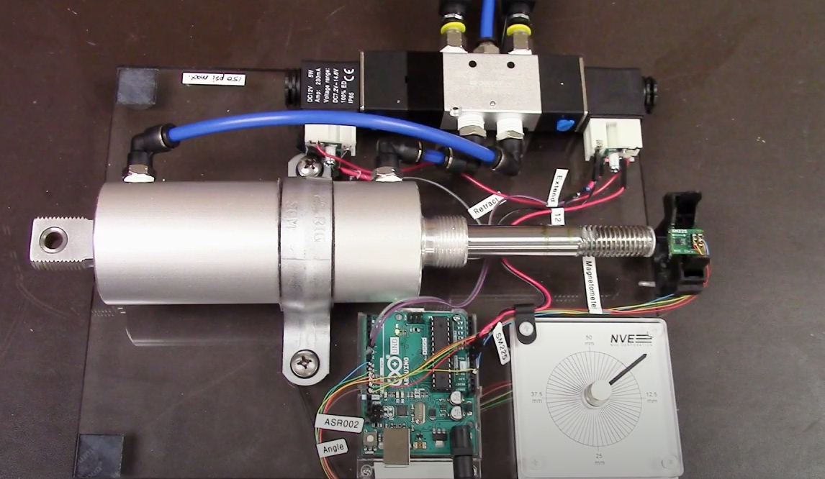
Use Case: Servo Systems
Parts used: SM-Series, ASR-Series
https://youtu.be/jAd1OAuO7wU

Slide 21

Use Case: Robotics and Prosthetics
Parts used:
SM-Series (tilt, actuation) ASR-Series (rotation)
Advantages More precise and repeatable
Robust airgap tolerances
High sensitivity
Ultraminiature packages
Parts used:
ALT-Series, AA-Series (tilt, actuation) AAT-Series (rotation)
Advantages
Ultralow power for battery power
No minimum supply voltage
Ultraminiature packages
www.nve.com/application-thumbnails

Slide 22
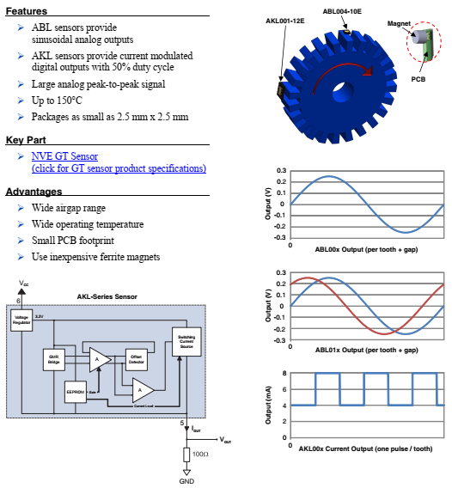
Use Case: Gear-Tooth Sensing
Applications
Robotics and mechatronics
Machine tools
Advantages
Detect small teeth (0.2 module)
Quadrature available
Speed range down to DC
www.nve.com/application-thumbnails

Slide 23
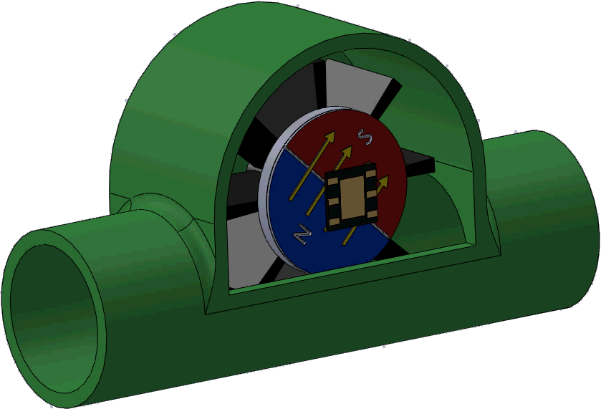
Use Case: Water Meter Sensors
https://youtu.be/JnN8JakxdnE
Parts used:
AAT001 / AAT006 Angle Sensors
<1 µA for battery operation
No minimum voltage supply
Large signals without amplification
Quadrature outputs for rotation direction
Ultraminiature
Sensor Output
ADT00x ultralow power digital water meter sensors also available
“The future belongs to structures with sensor networks that can monitor electricity and water usage in real time…”
—Forbes, Oct. 24, 2018
6/10/20

Slide 24
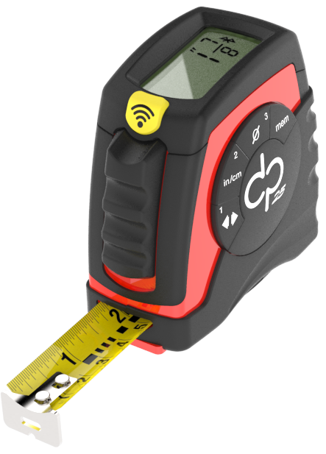
Use Case: Bluetooth Tape Measure
Part used: ASR002 Smart Angle Sensor
Concept to production in three months
Sensor has a good combination of accuracy and speed
Simple software
Fast prototyping using demo board and pseudocode
Minimal parts count on demo boards
6/10/20

Slide 25

Use Case: Anti-Tamper
Parts used: SM-Series
https://youtu.be/iscMubOcQ7E

Slide 26
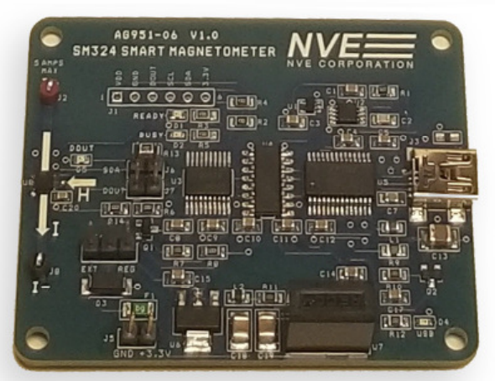
Evaluation and Demonstration Boards
Dozens of sensor evaluation and demonstration boards available
Self-contained
Work out-of-box
Show best practices

Slide 27



Sensor New Product Roadmap
1 tesla TMR Analog Sensor
(AKT001-14E)
Ultra high sensitivity TMR Analog Sensor
(ALT022-10E)
TMR Rotational / Linear Sensors (AETxxx-00E)
SM224-10E
Ultra high sensitivity TMR Smart Sensor
Ultraprecise Smart Angle Sensor
(ASR001-11E)
3Q 2020 | 4Q 2020 | 1Q 2021
Low-threshold TMR Switch
(AxT92x-14E)
½ tesla TMR Digital Sensor
(ADK991-14E)
9/22/20
Automotive
Medical
Proximity
NVE Confidential
Current
Angle
Smart
Sensor
Motor
Control

Slide 28
Summary
Revolutionary Sensing Technology
An Industry Leader
Boxes, Bullet-proof, Batteries, Brains
Broad product line
Extraordinary Support
6/10/20

Slide 29
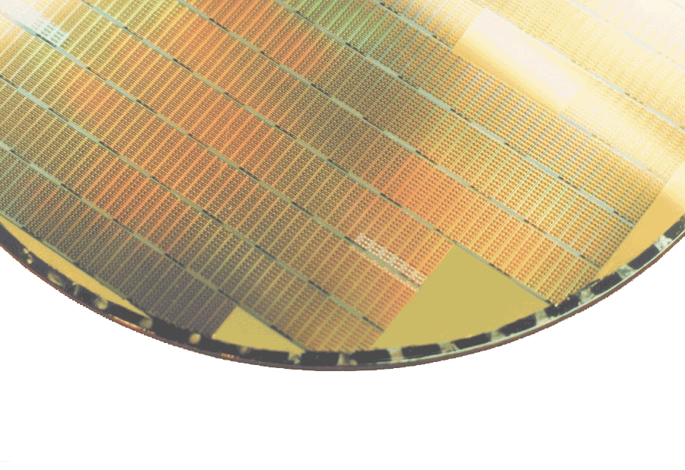
Certifications
ISO9001:2015 — Certified
UL — Registered
VDE — Certified (basic and reinforced insulation)
IATF 16949 — Letter of conformance
AEC Q100/Q101 — Approvals pending
6/10/20

Slide 30
Distributor/Rep Support Resources
Demos and Evaluation Kits
Videos
nve.com > Videos; www.youtube.com/NveCorporation
Reference Designs
nve.com/sensor-reference.php
Sensor Web Apps and Calulators
www.nve.com/spec/calculators.php
GitHub Repositories (software, datasheets, and manuals)
github.com/NveCorporation
Application Thumbnails
www.nve.com/application-thumbnails
Competitive Bulletins
http://www.nve.com/competition

