Slide 1


NVE CORPORATION
Isolators
Pete Eames
Dan Baker
May 07, 2020

Slide 2
  The IsoLoop four “Bs”:
  Boxes—MSOPs, QSOPs, SOICs, and True 8 mm creepage
  Baud—Highest speed; lowest jitter
  Batteries—Low power consumption
  Bullet-proof—Unlimited barrier life;
  best isolation voltage; radiation tolerant; low emissions
Slide 2

Slide 4
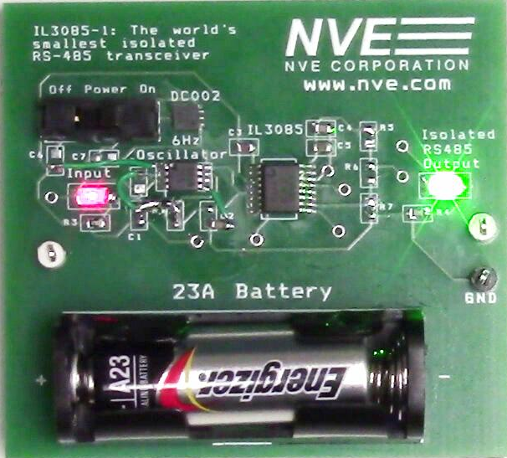
Transceiver Demo Board
Slide 4

Slide 5
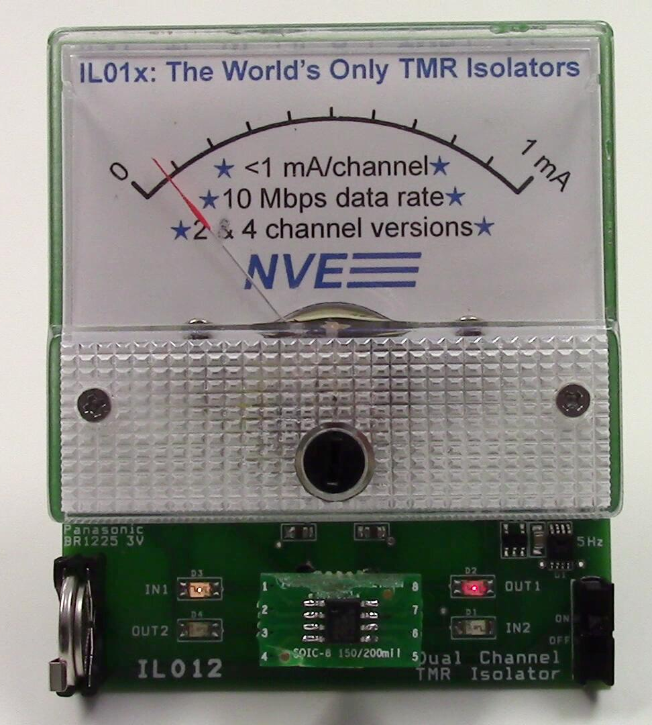
NEW!
Low-Power TMR Isolators (IL29xx / IL01x)
< 0.3 mA/channel typ. I_{ddq}
¼ power of flagship isolators
10 Mbps
RS-485 and data couplers
2.5 kV isolation
Slide 5

Slide 6
IsoLoop Isolator Features (all part families)
Up to 150 Mbps usable baud rate
100 ps jitter
Very low EM emissions and susceptibility
Radiation tolerant
Best isolation voltage (to 6 kVrms)
Polymer/ceramic barrier; 44000-year life
Unique MSOP packages
Unique True 8 (8 mm creepage) packages
Slide 6

Slide 7
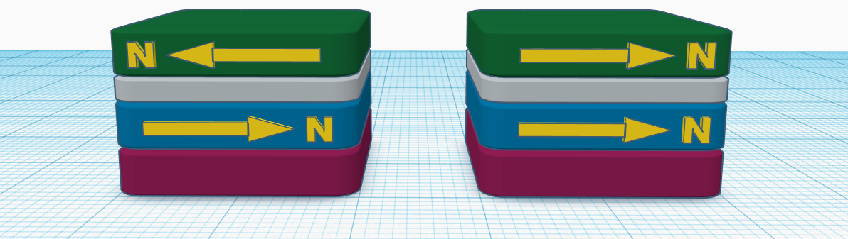
Isoloop Isolator Technology
Opposing
Magnetic Alignment
Aligned
Magnetic Alignment
Anti-aligned electron spins
increases quantum scattering
High electrical resistance
Aligned electron spins
decreases quantum scattering
Low electrical resistance
Spintronics!

Slide 8
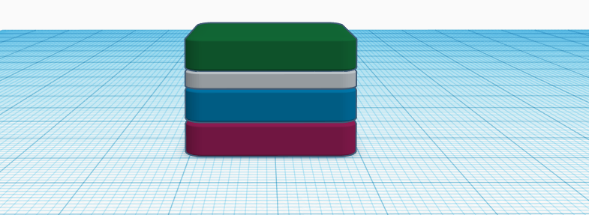
TMR vs. GMR Isolators
Giant Magnetoresistance (GMR)
Large signals
Low resistance for high speed
Tunneling Magnetoresistance (TMR)
Very large signals
Large resistance for low power
20-30 atoms thick
magnetic metal
copper
10-20 atoms thick
metal-oxide
20-30 atoms thick
magnetic metals
GMR/TMR Materials Stack

Slide 9
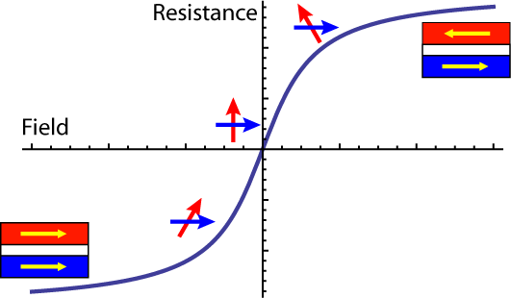
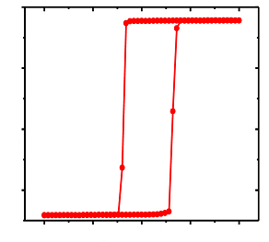
Digital and Linear GMR/TMR Films
Digital
Linear
Field
Field
Digital material
Latching state
Proportional material
“Linear” response
  Digital Isolators Materials
  Passive Input Materials
Magnetically latched outputs
Inherent EMI immunity
Digital states latched by CMOS
Inherent failsafe
Worlds only monolithic isolator
6/14/19

Slide 10
Isoloop Isolator
Model Signal Path
Magnetic
Fields
Data
In
Data
Out
Input Driver
On-chip Coil
Isolation Barrier
xMR Bridge
Output Driver

Slide 11
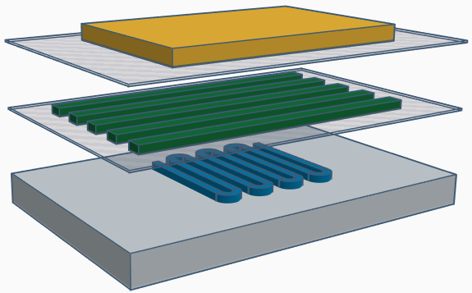
Isoloop Isolator Stack-up
Magnetic
Shield
Passivation
On-chip
Coil
Polymer/
Ceramic
Barrier
xMR
Resistor
Si Chip with
Active Circuitry

Slide 12
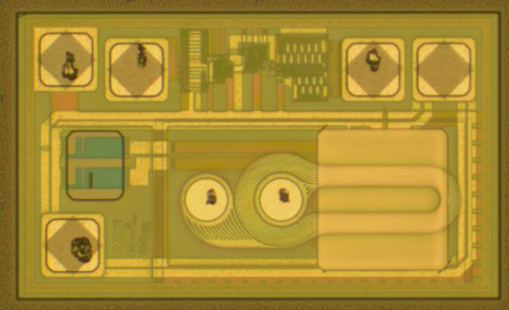
Isolator Chip Construction
Top-Down Die Image
Data Out
V_{ss}
Magnetic
Shield
On-chip
Coil
V_{dd}
0.2 mm
xMR
Resistors
Data In+/-

Slide 13
Best-in-Class Isolation Barrier
Unique polymer/ceramic composite barrier
Not susceptible to partial discharge,
which degrades barrier
Best isolation voltage (to 6 kVrms)
Best Working Voltage (to 1 kVrms)
Highest barrier resistance (10¹⁴ Ω)
No aging or diffusion (44000 year barrier life)
Slide 13

Slide 14
IsoLoop Product Families
New IL01x low-power TMR isolators
IL700/IL200 high-performance isolators
IL700VE/IL200VE high-voltage isolators
IL400/IL3000 isolated network transceivers
IL500-Series cost-effective isolators
IL600-Series passive-input isolators
New IL600CMTI-Series
IL800-Series top-of-the-line isolators
IL41050-Series Isolated CAN transceivers
IL4600-Series network transceivers + DC-DC
ILDC11 3V-3V DC-DC Converter
Coming soon
Slide 14

Slide 15
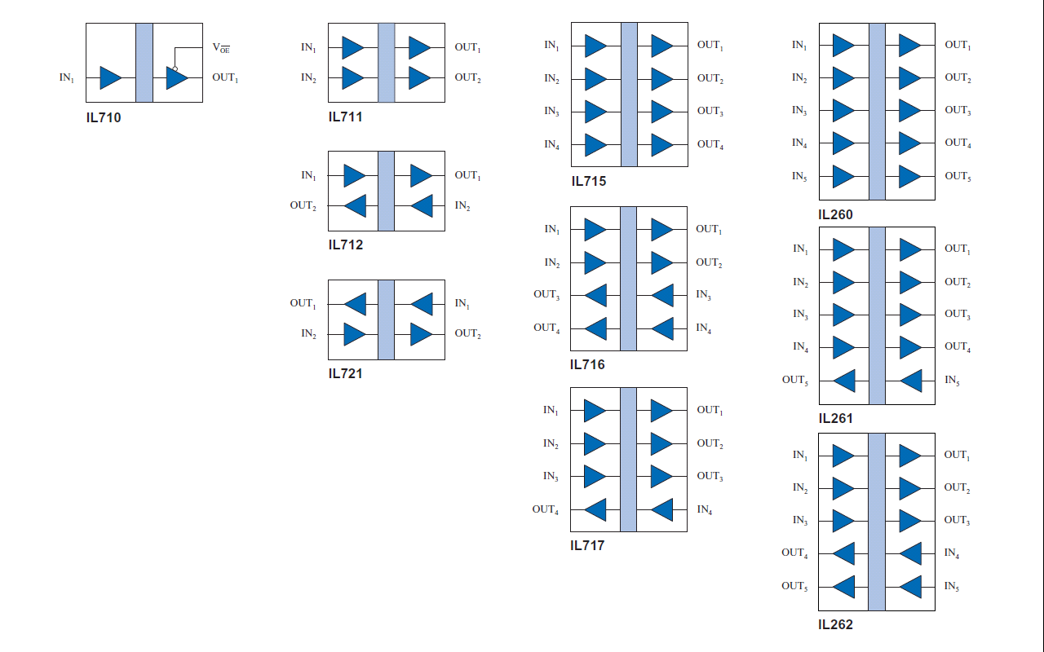

IL700/IL200 Series High-Performance Isolators
Low quiescent current (coil is powered only for switching)
3 ns pulse drive
Magnetic latching
Low EMI
High CMTI
1, 2, 4, and 5-channel configurations
Slide 15

Slide 16
IL700/IL200 Series High-Performance Isolators
110 Mbps, 3 ns PWD, 100 ps jitter
No clocks or RF carriers for superior EMC
Excellent AC and DC magnetic immunity
Several variants
  IL700-1 Series
  World’s smallest isolators (MSOP-8; QSOP-16)
  IL700S Series
  Fastest (150 Mbps); lowest PWD (300 ps)
  IL700T Series
  Highest operating temperature (125°C)
  IL700V Series
  Highest isolation voltage (6 kV)
Slide 16

Slide 17
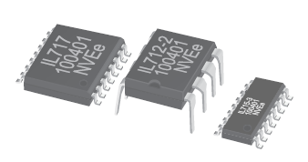

IL700/IL200 Series Key Specifications
Parameter | Min. | Typ. | Max. | Units
Data Rate (S-Series) | 100 (130) | 110 (150) |  | Mbps
PWD (S-Series) |  | 3 (0.3) | 3 | ns
Propagation Delay |  | 10 | 15 | ns
Pulse Jitter |  | 100 |  | ps
Transient Immunity | 30 | 50 |  | kV/µs
Quiescent Current |  | 1.5 | 2 | mA/ch
Temperature Range Std. IL700 Series T-Series IL200 Series | -40 -55 -40 |  | +100 +125 +85 | °C
Slide 17

Slide 18
IL400 and IL3000 Series Isolated Transceivers
IL422 / IL485
IL3022 / IL3522
IL3122 / IL3185
IL3222 / IL3285
IL3422 / IL3485
IL41050TA/IL41050TT
IL41050TFD
IL485W
IL2985 / IL3085 / IL3585 / IL3685
Slide 18

Slide 19
Isolated Network Transceivers
RS-422, RS-485, PROFIBUS, and CAN
Digital or passive input versions
Up to 40 Mbps
Rigorous PROFIBUS compliance
True 8 mm creepage available
QSOP and narrow-body versions
Slide 19

Slide 20
IL500 Series Cost-Effective Isolators
2 Mbps
DC-correct power-up
–40°C to +85°C
MSOP and SOIC packages
Slide 20

Slide 21
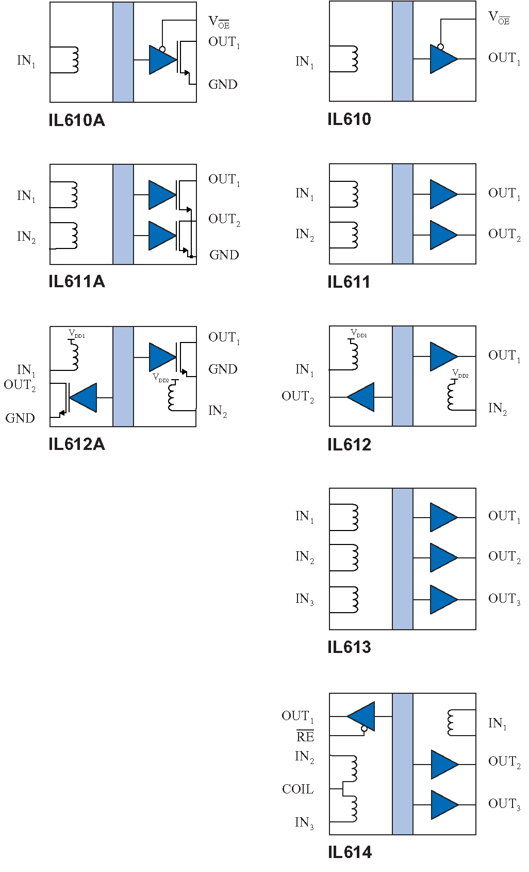
IL600-Series Passive Input Isolators
Current-sensitive passive inputs
CMOS or open-drain output
Wide input voltage range
Very high transient immunity
Inherent failsafe output
Slide 21

Slide 22
IL600-Series Passive-Input IsoLoop® Isolators
Analogous to optocoupler but far more reliable
5-8 mA drive current
Very high CMTI
Inherent failsafe output
Slide 22
The opto alternative

Slide 23
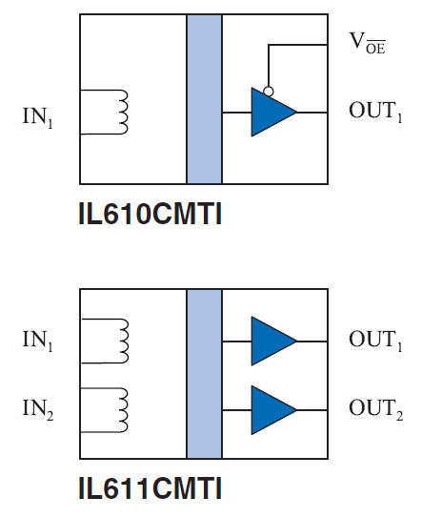
IL600CMTI-Series Isolators
NEW!
Ultrahigh CMTI Isolated MOSFET Drivers
200 kV/µs guaranteed CMTI; 300 kV/µs with deglitch
Extended 3 V to 6.6 V power supply range
Switching frequencies up to 50 MHz

Slide 24
IL800 Series Top-of-the Line Isolators
Combine IL700 speed, IL700T temperature, and IL500 DC-correct
110 Mbps
DC-correct power-up
–40°C to +125°C
MSOP, SOIC, and True 8™ packages
Slide 24

Slide 25
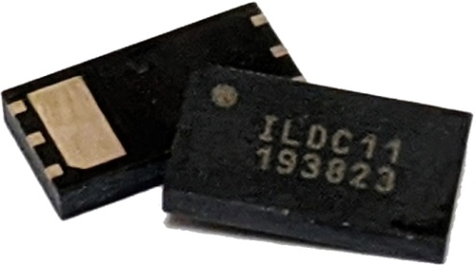

Isolated Power Devices
Coming
May 2020
ILDC11
World’s smallest DC-DC convertor
3.3 V input to 3.3 V output
Quarter watt output power
Fully-regulated output
Low EMI
Full 2500 V isolation
−40 °C to 125 °C
IL4622
IL4685

Slide 26
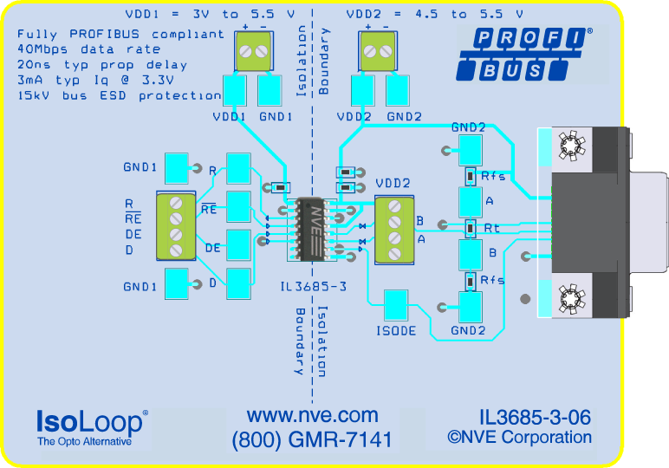
Evaluation Boards
Dozens of sensor and isolator boards
Show best practices
Work out of the box
Many are under $100
Slide 26

Slide 27
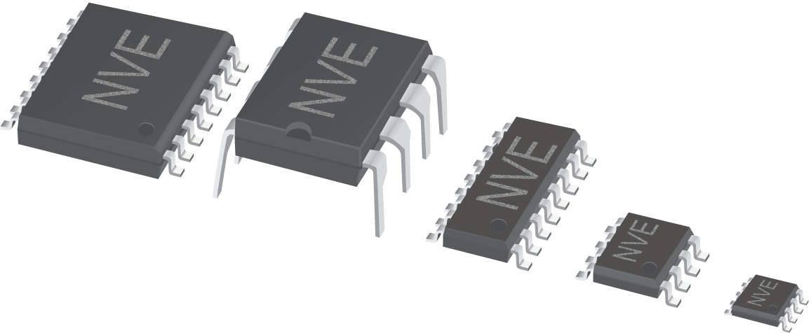
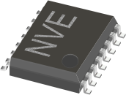
Isolator Packages
Exclusive
QSOP
transceivers
Exclusive
MSOP
Slide 27

Slide 28
VE-Series Ultra-High Voltage Isolators
Slide 28
Notes:
Wave 7 is the 7th iteration of our latest push to improve isolators.

Slide 29
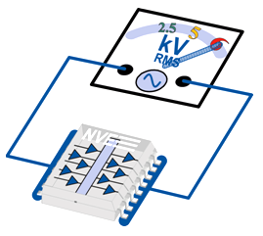
VE-Series Ultra-High Voltage Isolators
Best-in-class high-voltage performance
  6 kVrms isolation
  1 kVrms Working Voltage per VDE V 0884-11
  12.8 kV surge immunity per VDE V 0884-11
  >600 V CTI per IEC 60601
  True 8 mm creepage per IEC 60601
Slide 29

Slide 30
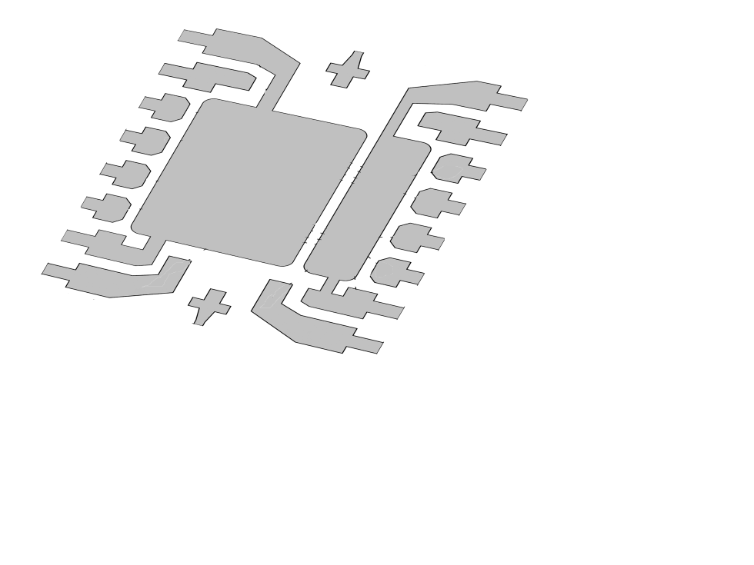
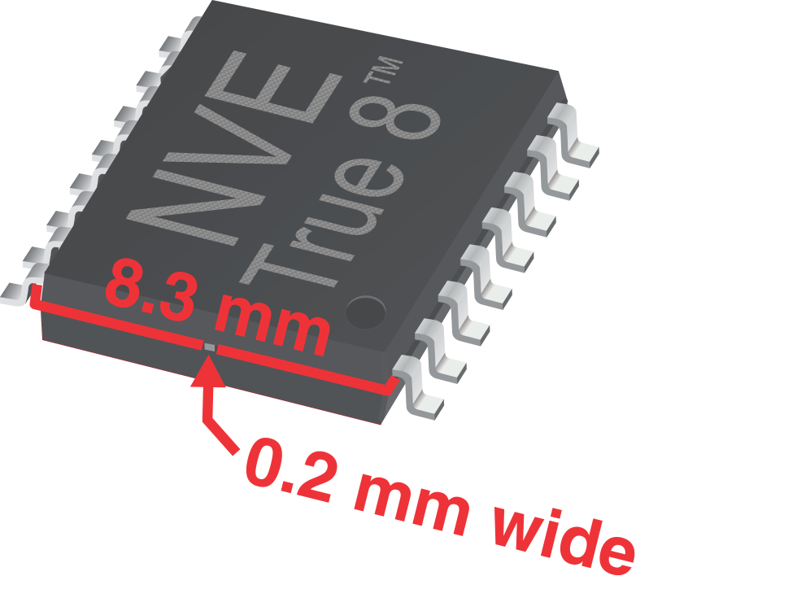
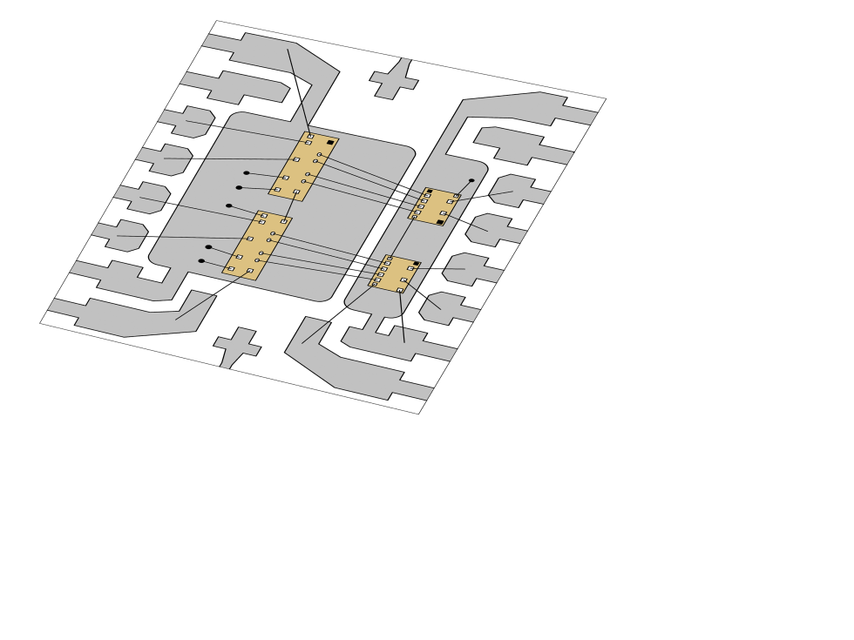
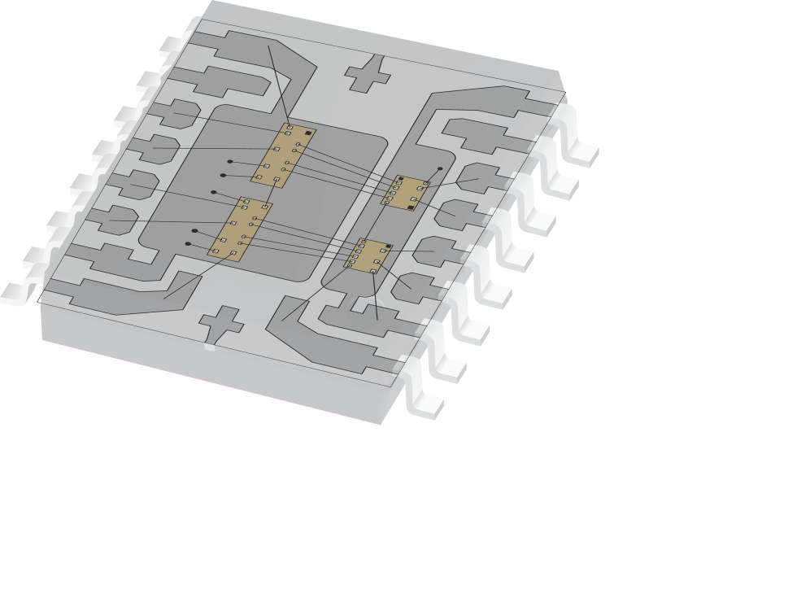
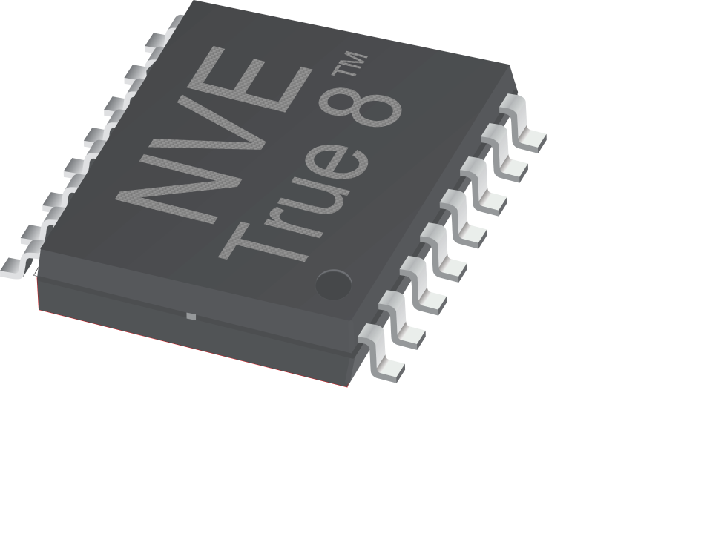
True 8™ (True 8 mm Creepage) Package
Slide 30

Slide 31
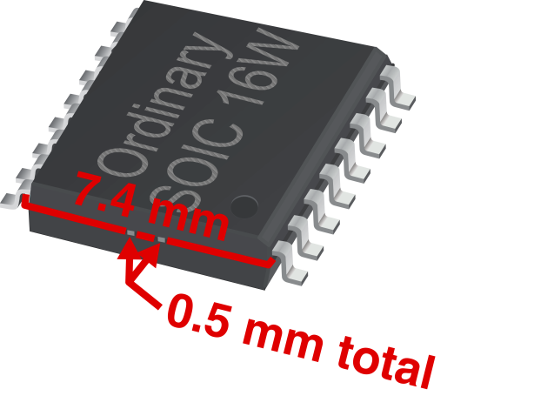

True 8™ (True 8 mm Creepage) Package
 |  | + | − | =
Package | End Width | Pin-to-end Spacing (total) | Surface Metal Subtraction | Typical Creepage
Ordinary wide-body package | 7.4 mm | 0.7 mm | 0.5 mm | 7.1 mm
NVE True 8™ package | 7.5 mm | 1.0 mm | 0.2 mm | 8.3 mm
Slide 31

Slide 32


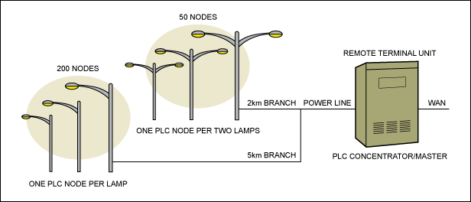
NVE Isolator Markets
Industrial control (interfaces; networks)
Medical instruments
Energy (smart grids; power supplies)
Automotive
(CAN interfaces; battery management systems)
Slide 32

Slide 33
IsoLoop Isolator Summary
Revolutionary technology
An industry leader
Boxes; Baud; Batteries; Bullet-Proof
Broad product line
Extraordinary support
Slide 33

Slide 34



Isolator New Product Roadmap
Solder Bumped Hi Current QFN Regulator
(DC002-90E)
RS422 w/DC-DC Convertor
(IL4622E)
3 x 5.5 mm
DC-DC Convertor
(ILDC11-15E)
RS485 w/DC-DC Convertor
(IL4685E)
Data couplers w/ DC-DC Convertor
(IL76xxE)
1Q 2020 | 2Q 2020 | 3Q 2020
Ultrahigh CMTI Isolators
(IL6xxCMTI)
= Low power
= Rugged
= Small
Slide 34
3/24/20

Slide 35
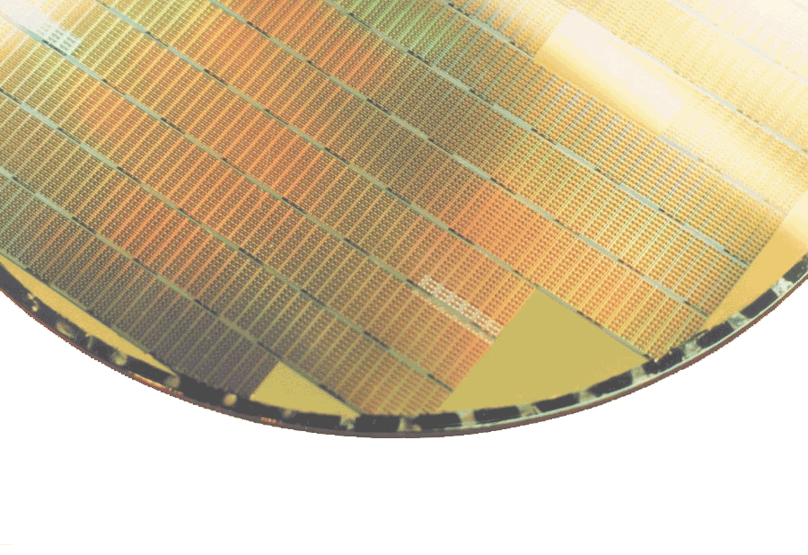
Isolator Certifications
ISO9001:2015 — Certified
UL — Registered
VDE — Certified (basic and reinforced insulation)
IATF 16949 — Letter of conformance
7/1/19

Slide 36
Distributor/Rep Isolator Support Resources
Demos and Sample Kits
As needed…
Videos
nve.com > Videos; www.youtube.com/NveCorporation
Reference Designs
www.nve.com/isoapps-reference.php
Competitive Isolator Cross Reference
http://www.nve.com/xref/
Competitive Bulletins
http://www.nve.com/competition

